Slide 1
Sequence a genome (SAGE II)
Master Molecular Life Sciences
Department of Fundamental Microbiology, University of Lausanne

Slide 2
Analyzing bacterial communities diversity with 16S data

Slide 3
Content
Background
Overall workflow
Exploring the data
The count table
The taxonomy table
Analyzing the data
Taxon analysis
Alpha-diversity
Beta-diversity
Our topic: water kefir microbiota
Diversity analyses in R

Slide 4

Background: community ecology
How diverse are these environments?

Slide 5
Background: community ecology
How many species?
In which abundance?
Similar species?
QUALITY
= What is in there?
Which species
QUANTITY
= How many?
How many species? In which abundance?

Slide 6
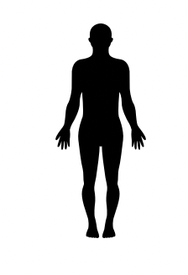


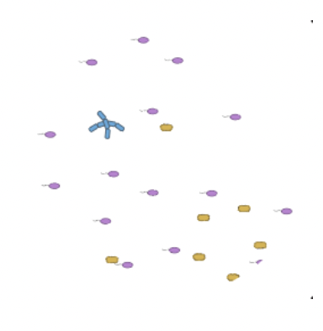
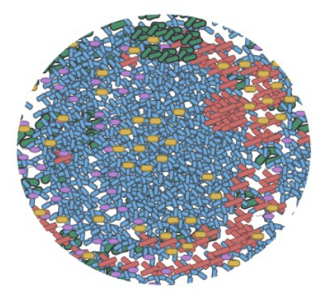
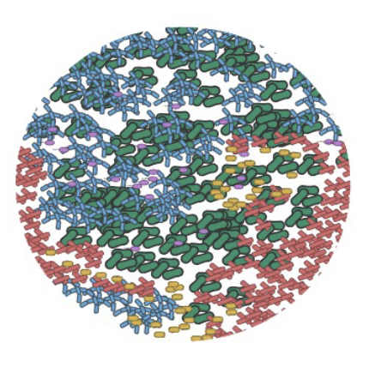
Background: community ecology
Community : a set of populations (= individuals from same species) coexisting in the same space and time
Notes:
Integrative levels of organization: individuals > populations>communities

Slide 7
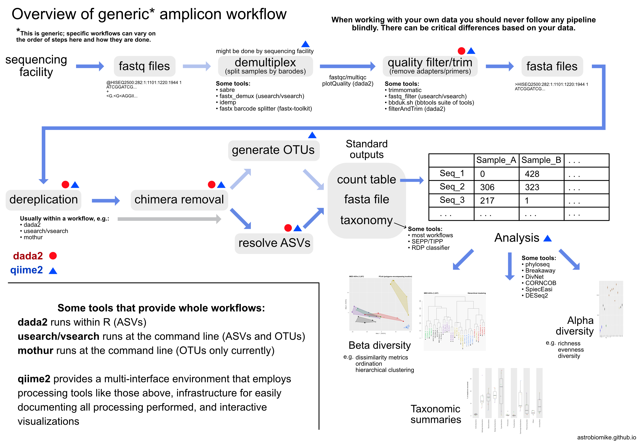
16S analyses overall workflow
Notes:
One of the best ways, or at least most common ways, to characterize bacterial communities is to use 16S amplicon data. Because it is going to allow us to count the number of individuals from the different species present in a community.
Here we have the workflow of how do we analyze 16S amplicon data. It comes from the website astrobiomike.github.org.
So far you have already learnt how to use dada2 and obtain the final output of the data2 workflow

Slide 8

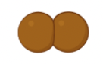
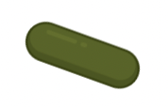
Exploring the data
Input data: the count table
TAXA
OTUs, ASVs, Strains, Species
50 | 100 | 100
100 | 50 | 200
100 | 0 | 5
OBSERVATIONS
COUNTS
Individuals,
Cells,
Reads,
Fluorescence,
Biomass,
Proportions
Sites,
Samples,
Regions,
Hosts

Slide 9
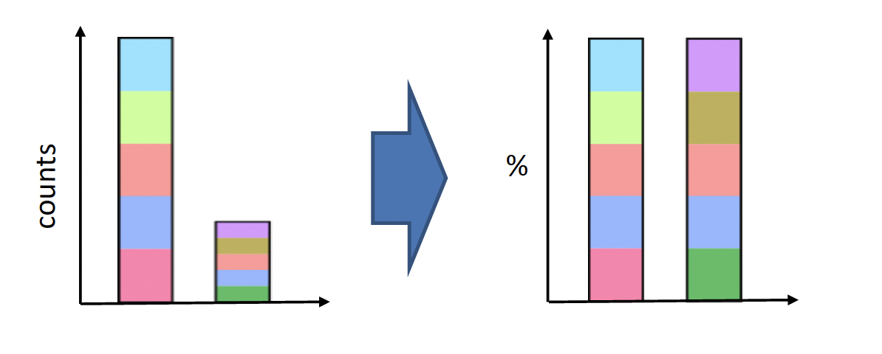
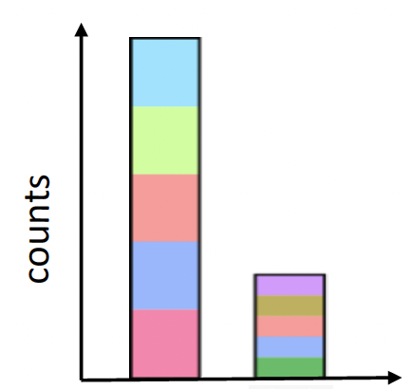
Exploring the data
Absolute versus relative abundances
Normalize again with some measure of absolute abundance (qPCR, FlowCyto…)
Notes:
The main characteristic of 16S amplicon data is that we have access to count data and not absolute abundances. The true abundances in an environment suffers different technical pitfalls:
The sample is not always representative of the environment, it’s a subselection
It is hard to have equimolar concentrations of all samples, to standardize the process
The technology used generates counts, which is a different concept than abundance (for example because some species have several copies of the same 16S gene while others only have one copy)
We usually transform absolute counts into relative counts to be able to compare samples between themselves. But we lose with this step one of the dimensions of absolute abundance, even if as mentioned abundances are different than counts. It can be nice to always keep in your dataset some measure of absolute abundance, or at least absolute counts (qPCR for example).

Slide 10
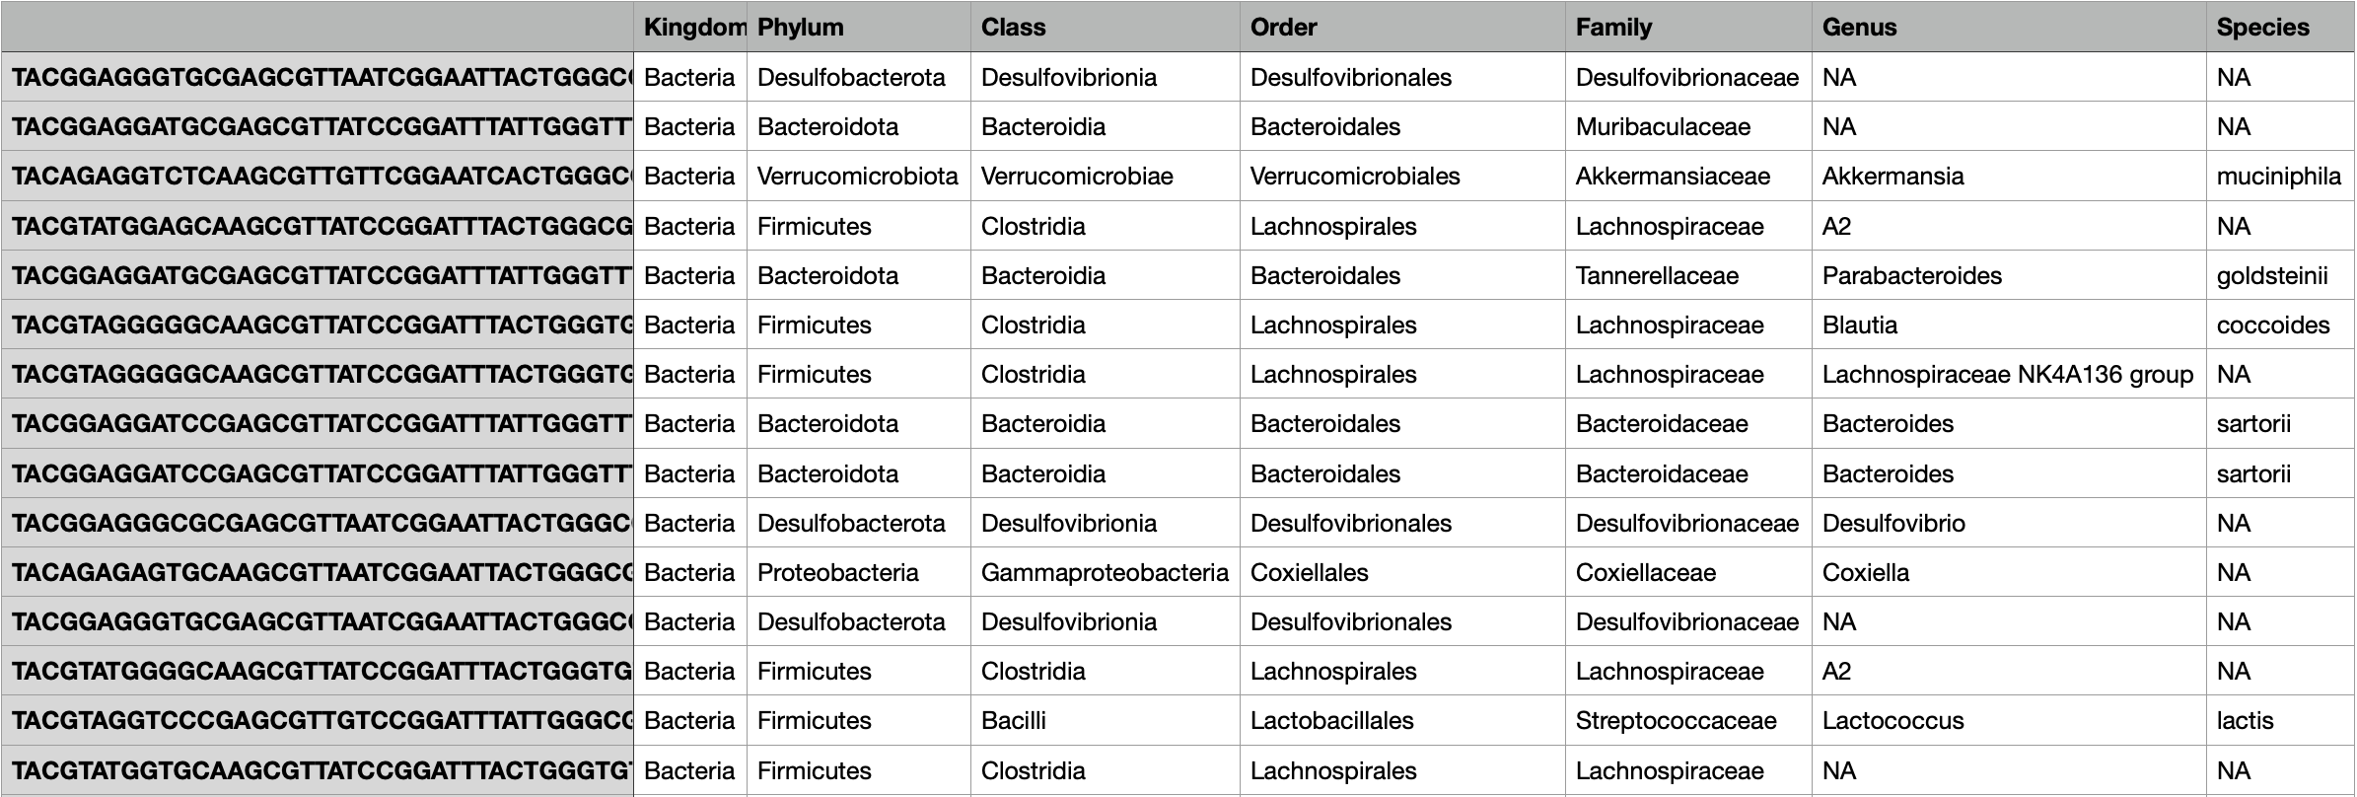
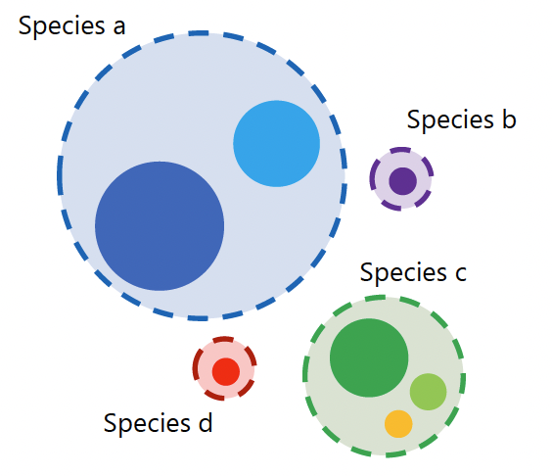
Exploring the data
Input data: the taxonomy table

Slide 11
Analyzing the data
Taxon-level analysis
𝛂-diversity analysis
𝛃-diversity analysis

Slide 12
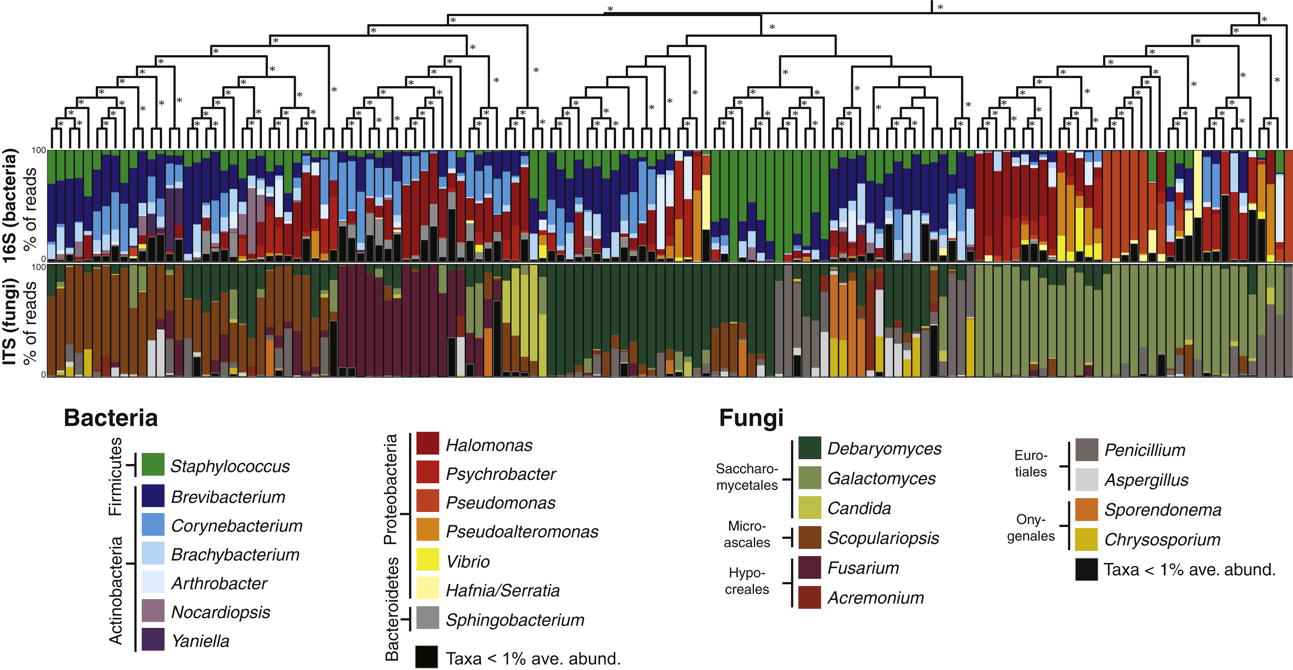
Analyzing the data
Taxon-level analysis
First things first: what is in there?
Barplot of relative abundance of main taxa
Different taxonomic levels
Mean relative abundance of main taxa
Differential abundance statistical testing across treatment groups
Sanity check and link to microbiology
Data is compositional!
Wolfe BE et al. (2014)

Slide 13
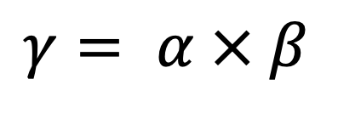
Analyzing the data
Diversity analysis
Biodiversity is a measure of the magnitude of genetic, species and ecological variation in an ecosystem
$$γ= α × β$$
The total diversity within a landscape is called 𝛄-diversity and consists of two components

Slide 14
Analyzing the data
𝛂-diversity analysis
…the local variation contained in each sample, or 𝛂-diversity…
$$γ= α × β$$
→ “Quantity” of “species” of ONE microbiome

Slide 15
Analyzing the data
𝛃-diversity analysis
…and the degree of dissimilarity between samples/sites, known as 𝛃-diversity
$$γ= α × β$$

Slide 16
Analyzing the data
𝛂-diversity analysis
Measures the diversity within a sample
How many species? → Richness
In equal numbers? → Evenness
Depends on the taxonomic level (ASV, species, genus)
C “features” (taxa, genes, transcripts…) in proportions p₁, p₂, ..., p_{C} in a sample → relative abundance data
50 | 100 | 100
100 | 50 | 200
100 | 0 | 5
Notes:
Any function of p1, p2, … pC is a valid alpha diversity parameter

Slide 17
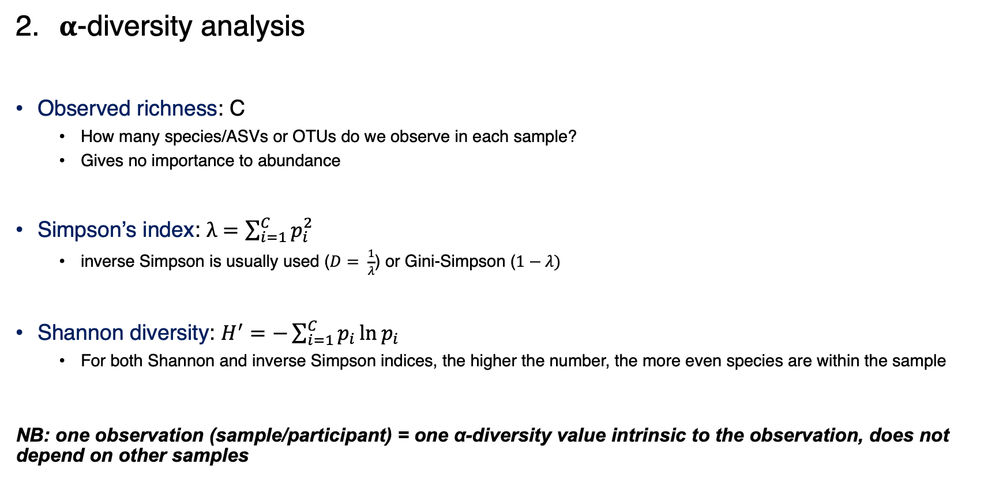
Analyzing the data
𝛂-diversity analysis
Observed richness: C
How many species/ASVs or OTUs do we observe in each sample?
Gives no importance to abundance
Simpson’s index: $λ=\sum_{i=1}^{C}{p_{i}^{2}}$
inverse Simpson is usually used ($D= \frac{1}{λ}$) or Gini-Simpson ($1−λ)$
Shannon diversity: $H^{′}=−\sum_{i=1}^{C}{p_{i}\ln{p_{i}}}$
For both Shannon and inverse Simpson indices, the higher the number, the more even species are within the sample
NB: one observation (sample/participant) = one α-diversity value intrinsic to the observation, does not depend on other samples
Taxonomic richness
Observed richness
Shannon
Simpson
Taxonomic evenness
Notes:
Any function of p1, p2, … pC is a valid alpha diversity parameter

Slide 18
Analyzing the data
𝛂-diversity analysis
Observed richness: C
How many species/ASVs or OTUs do we observe in each sample?
Gives no importance to abundance
Obs C
50 | 100 | 100 | 3
100 | 50 | 200 | 3
100 | 0 | 5 | 2
Remember that singletons are eliminated from the dataset in the dada2 pipeline
If you want to compare samples, how do you account for different total abundances per sample?
Notes:
Any function of p1, p2, … pC is a valid alpha diversity parameter

Slide 19
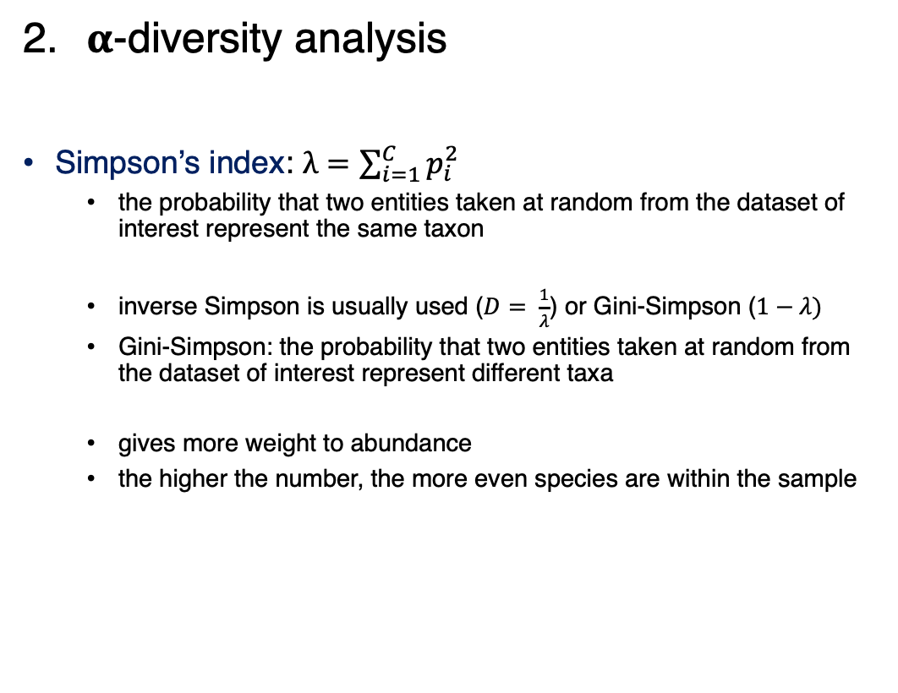
Analyzing the data
𝛂-diversity analysis
Simpson’s index: $λ=\sum_{i=1}^{C}{p_{i}^{2}}$
the probability that two entities taken at random from the dataset of interest represent the same taxon
inverse Simpson is usually used ($D= \frac{1}{λ}$) or Gini-Simpson ($1−λ)$
Gini-Simpson: the probability that two entities taken at random from the dataset of interest represent different taxa
gives more weight to abundance
the higher the number, the more even species are within the sample
D
50 | 100 | 100 | 2.78
100 | 50 | 200 | 2.33
100 | 0 | 5 | 1.10
Notes:
Any function of p1, p2, … pC is a valid alpha diversity parameter

Slide 20
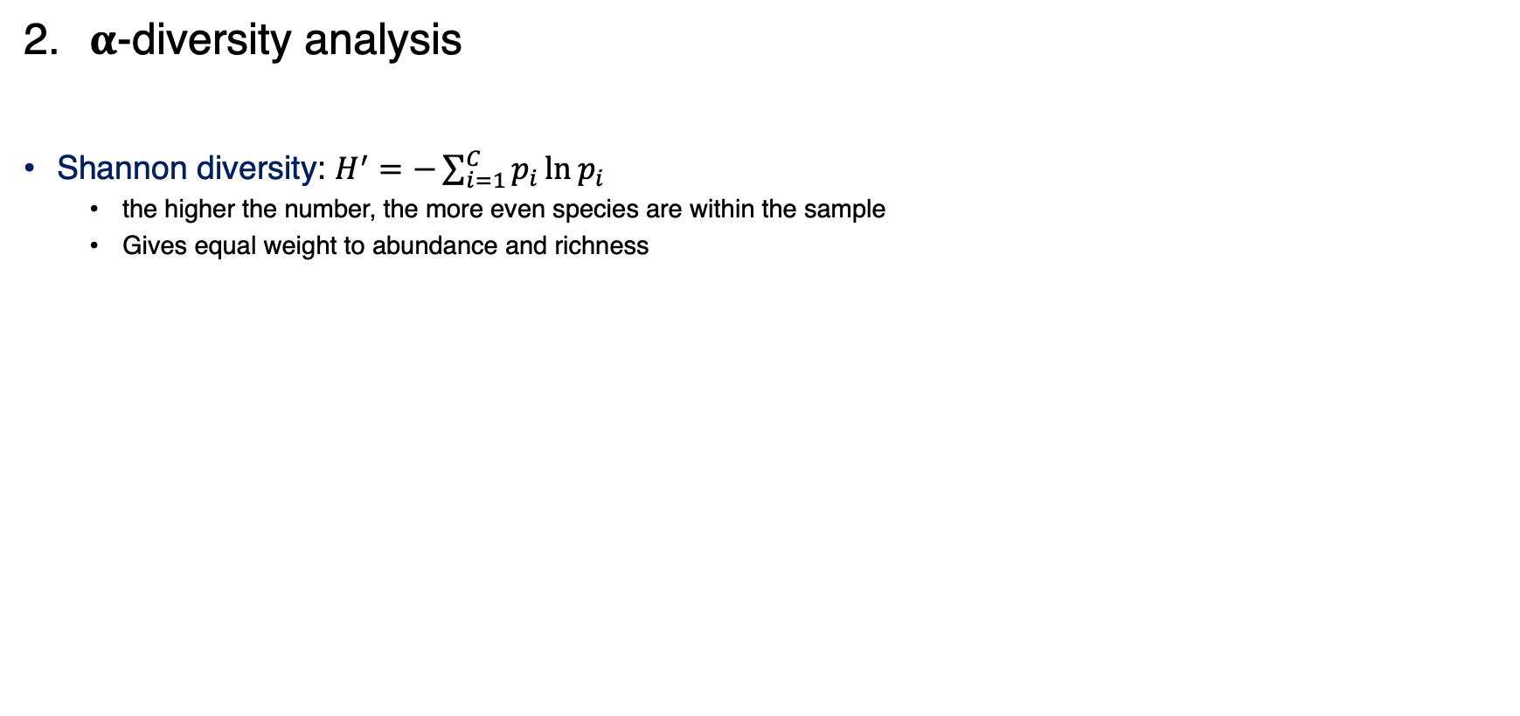
Analyzing the data
𝛂-diversity analysis
Shannon diversity: $H^{′}=−\sum_{i=1}^{C}{p_{i}\ln{p_{i}}}$
the higher the number, the more even species are within the sample
Gives equal weight to abundance and richness
H’
50 | 100 | 100 | 1.05
100 | 50 | 200 | 0.96
100 | 0 | 5 | 0.19
Remember that you only took one sample, replicates would give you similar but different values
Notes:
Any function of p1, p2, … pC is a valid alpha diversity parameter

Slide 21
Analyzing the data
Rarefaction
Is it fair to compare their richness?
Usually, the more reads you get, the more ASVs you can observe
You might miss out ASVs if you have a low sequencing depth
How can we standardize unequal sequencign depths for comparison?
# reads = 6, # ASV = 2
# reads = 3, # ASV = 3

Slide 22
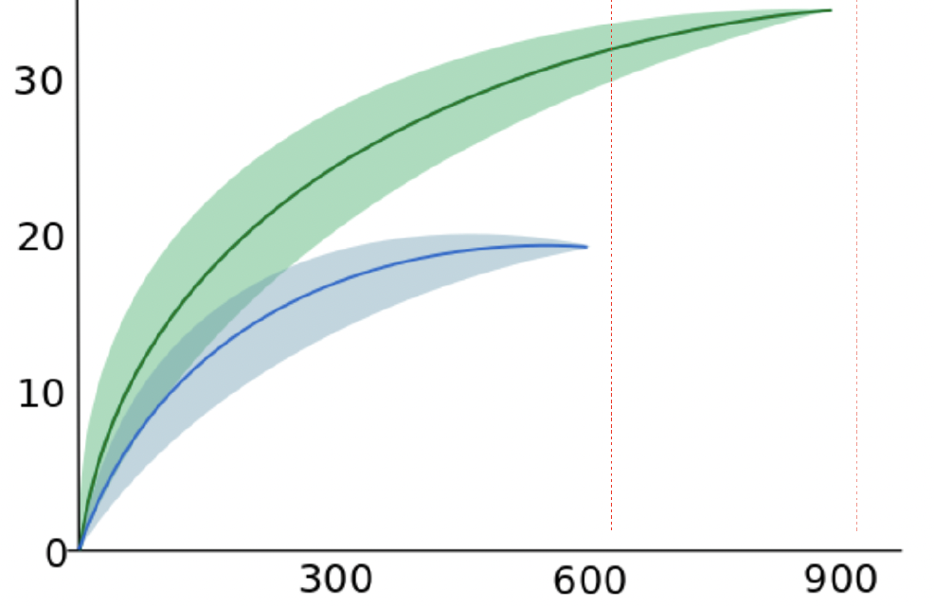
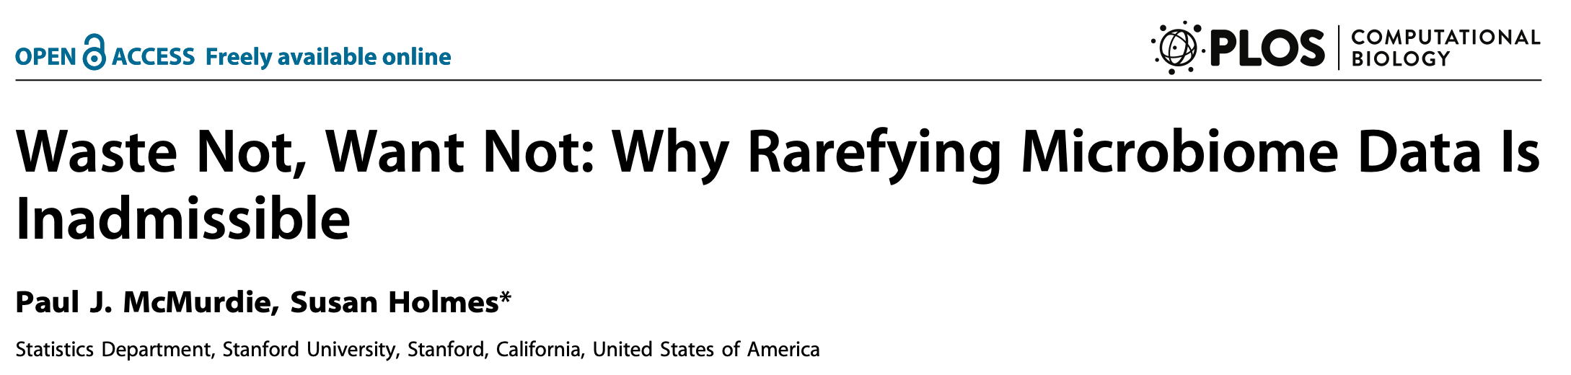
Analyzing the data
Rarefaction
With subsampled (rarefied) datasets!
The plateau corresponds to the true richness
Rarefy = subsample to get the same number of reads per sample
# ASVs
Be careful: by randomly throwing away reads until all samples have the same depth, you lose information
Statistical models that account for different sequencing depths are better approaches
# reads
# reads = 3, # ASV = 1
# reads = 3, # ASV = 3

Slide 23
Analyzing the data
𝛃-diversity analysis
…and the degree of dissimilarity between samples/sites, known as 𝛃-diversity
$$γ= α × β$$

Slide 24
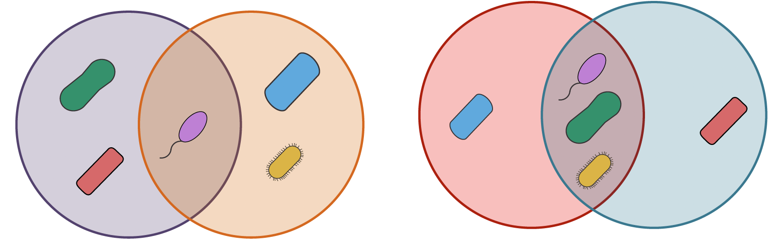
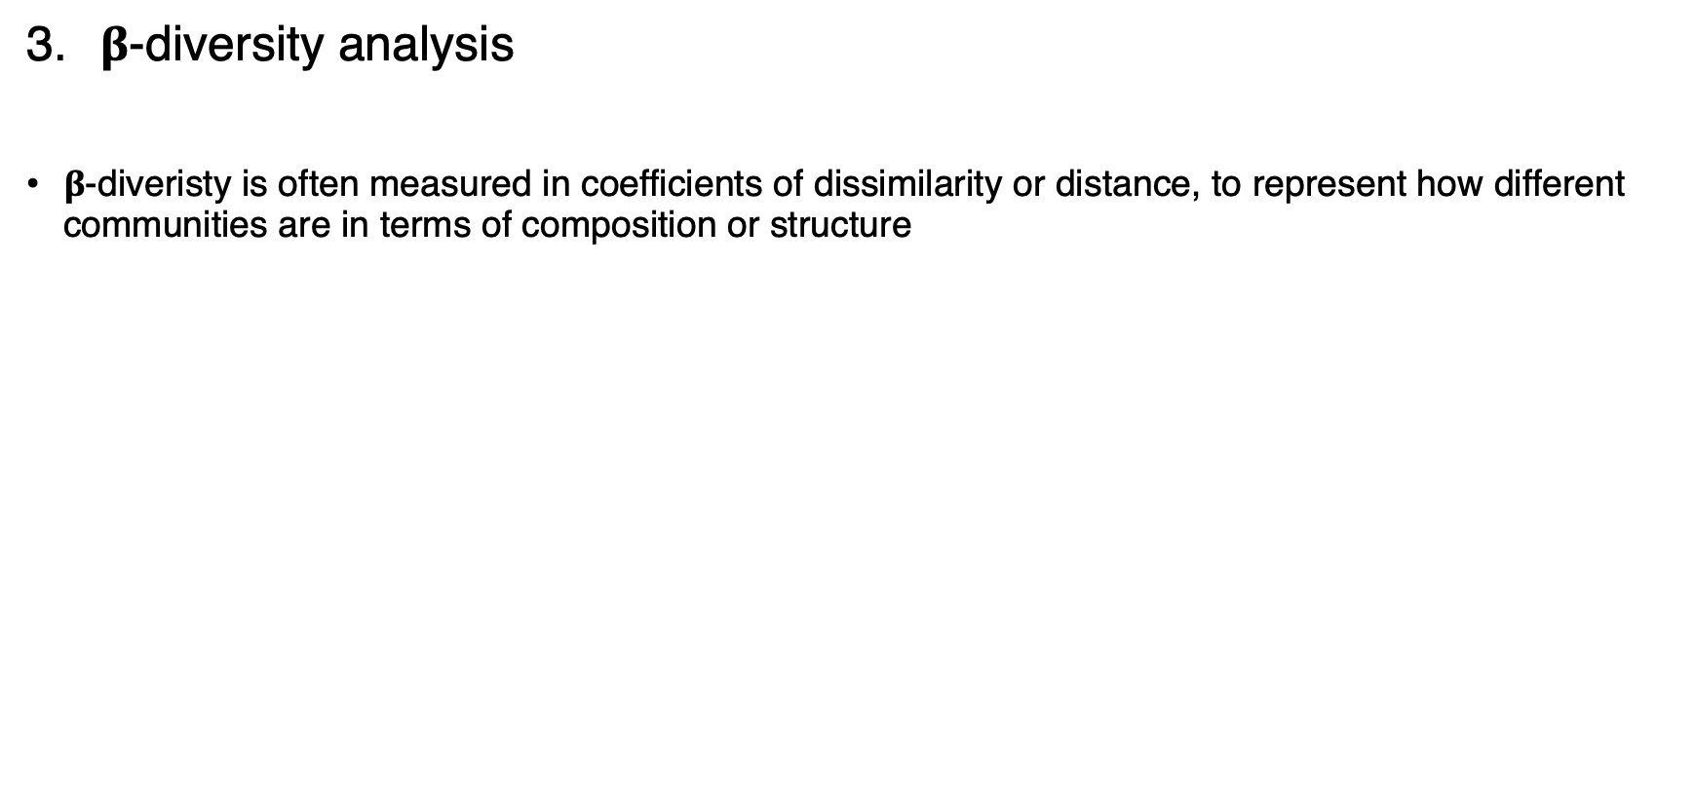
Analyzing the data
𝛃-diversity analysis
$β$-diveristy is often measured in coefficients of dissimilarity or distance, to represent how different communities are in terms of composition or structure
Few shared ASVs
High 𝛃-diversity
Low similarity
Many shared ASVs
Low 𝛃-diversity
High similarity

Slide 25
Analyzing the data
NB: two observations = one 𝛃-diversity value
𝛃-diversity analysis
How do we measure (dis-)similarity between samples?
50 | 100 | 100
100 | 50 | 200
100 | 0 | 5
1 | S_{1,2} | S_{1,3}
S_{1,2} | 1 | S_{2,3}
S_{1,3} | S_{2,3} | 1

Slide 26
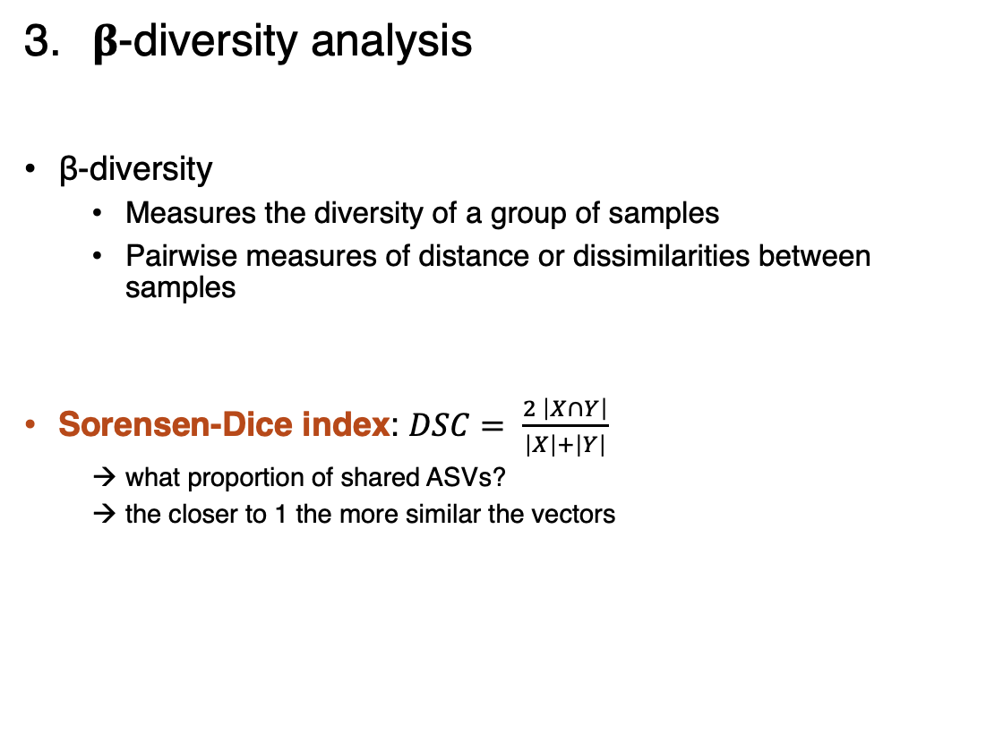
Analyzing the data
𝛃-diversity analysis
β-diversity
Measures the diversity of a group of samples
Pairwise measures of distance or dissimilarities between samples
Sorensen-Dice index: $DSC= \frac{2 \left|X∩Y\right|}{\left|X\right|+\left|Y\right|}$
what proportion of shared ASVs?
the closer to 1 the more similar the vectors
NB: two observations = one 𝛃-diversity value
1
1 | 1
0.6 | 0.6 | 1
X
Y

Slide 27
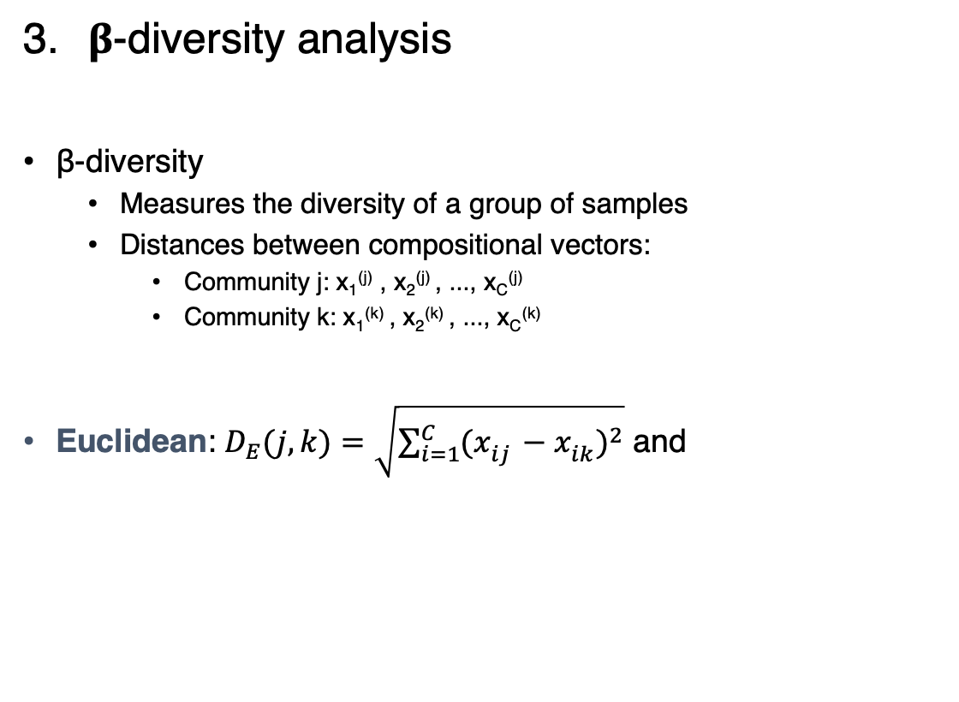
Analyzing the data
𝛃-diversity analysis
β-diversity
Measures the diversity of a group of samples
Distances between compositional vectors:
Community j: x₁^{(j)} , x₂^{(j)} , ..., x_{C}^{(j)}
Community k: x₁^{(k)} , x₂^{(k)} , ..., x_{C}^{(k)}
Euclidean: $D_{E}(j, k)=\sqrt{\sum_{i=1}^{C}{{(x_{ij}^{}−x_{ik}^{})}^{2}}}$ and
NB: two observations = one 𝛃-diversity value
0
122.5 | 0
146.7 | 201.3 | 0

Slide 28
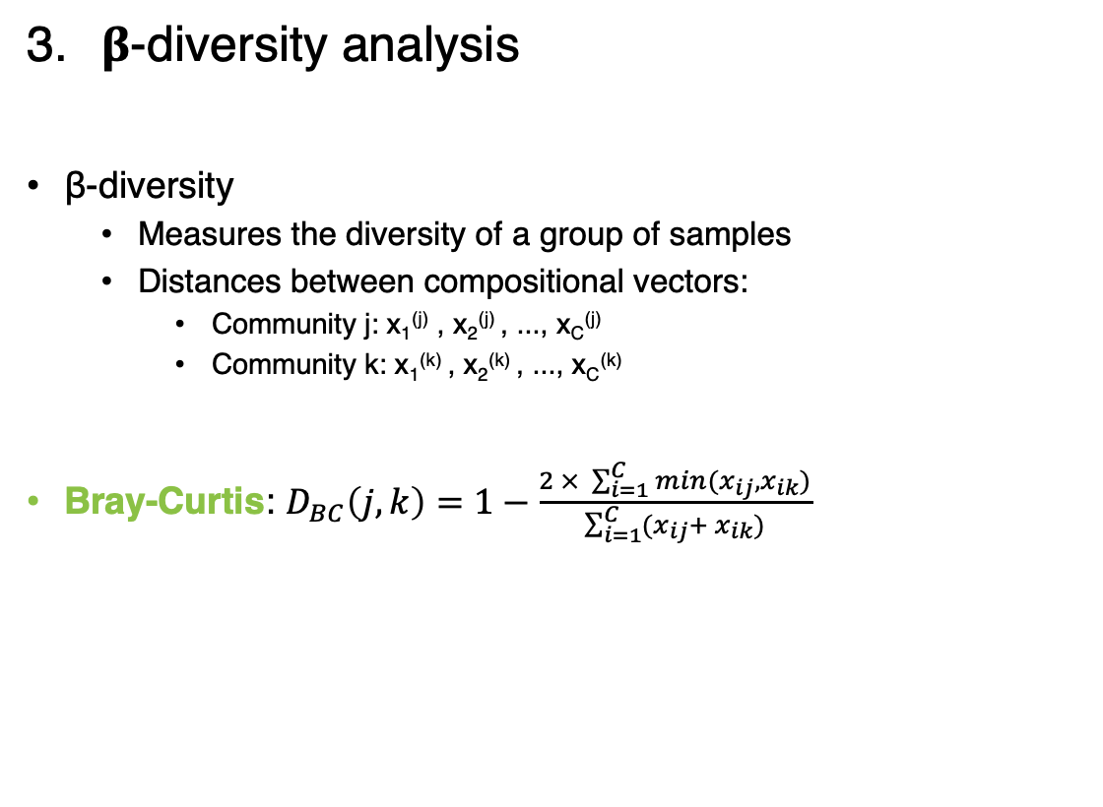
Analyzing the data
𝛃-diversity analysis
β-diversity
Measures the diversity of a group of samples
Distances between compositional vectors:
Community j: x₁^{(j)} , x₂^{(j)} , ..., x_{C}^{(j)}
Community k: x₁^{(k)} , x₂^{(k)} , ..., x_{C}^{(k)}
Bray-Curtis: $D_{BC}\left(j,k\right)=1−\frac{2 × \sum_{i=1}^{C}{min(x_{ij},x_{ik})}}{\sum_{i=1}^{C}{(x_{ij}+ x_{ik})}}$
NB: two observations = one 𝛃-diversity value
0
0.33 | 0
0.69 | 0.54 | 0

Slide 29
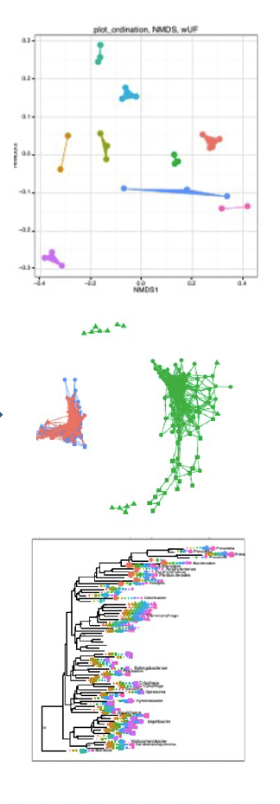
Analyzing the data
𝛃-diversity analysis
Ordination plots
50 | 100 | 100
100 | 50 | 200
100 | 0 | 5
1 | 0.33 | 0.69
0.33 | 1 | 0.54
0.69 | 0.54 | 1
Networks
Clustering
Count table
Distance matrix
Notes:
Ordination and classification (or clustering) are the two main classes of multivariate methods that community ecologists employ. To some degree, these two approaches are complementary. Classification, or putting samples into (perhaps hierarchical) classes, is often useful when one wishes to assign names to, or to map, ecological communities. However, given the continuous nature of communities, ordination can be considered a more natural approach. Ordination aims at arranging samples or species continuously along gradients.

Slide 30
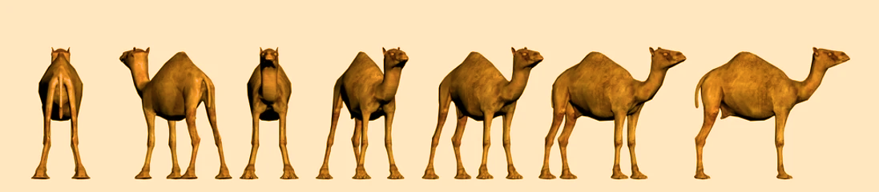
Analyzing the data
Ordination plots
“Ordination is a collective term for multivariate techniques which summarize a multidimensional dataset in such a way that when it is projected onto a low dimensional space, any intrinsic pattern the data may possess becomes apparent upon visual inspection” (Pielou, 1984)
Attempt to best represent the distances on a limited number of axes

Slide 31
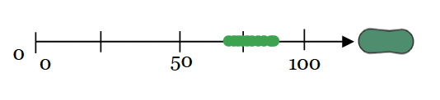
Analyzing the data
Ordination plots
1-dimension

Slide 32
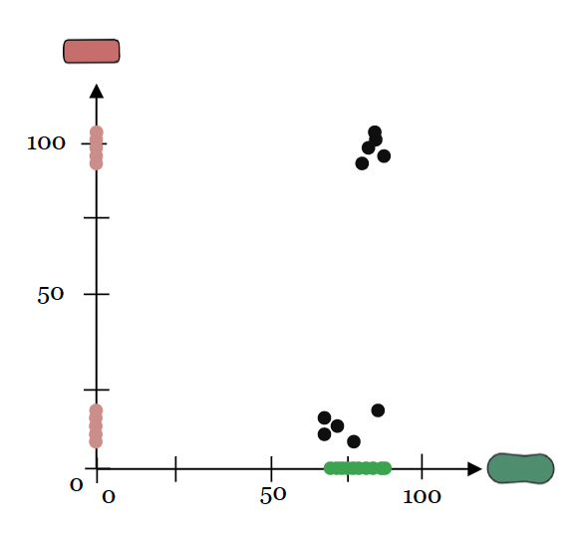
Analyzing the data
Ordination plots
2-dimensions

Slide 33
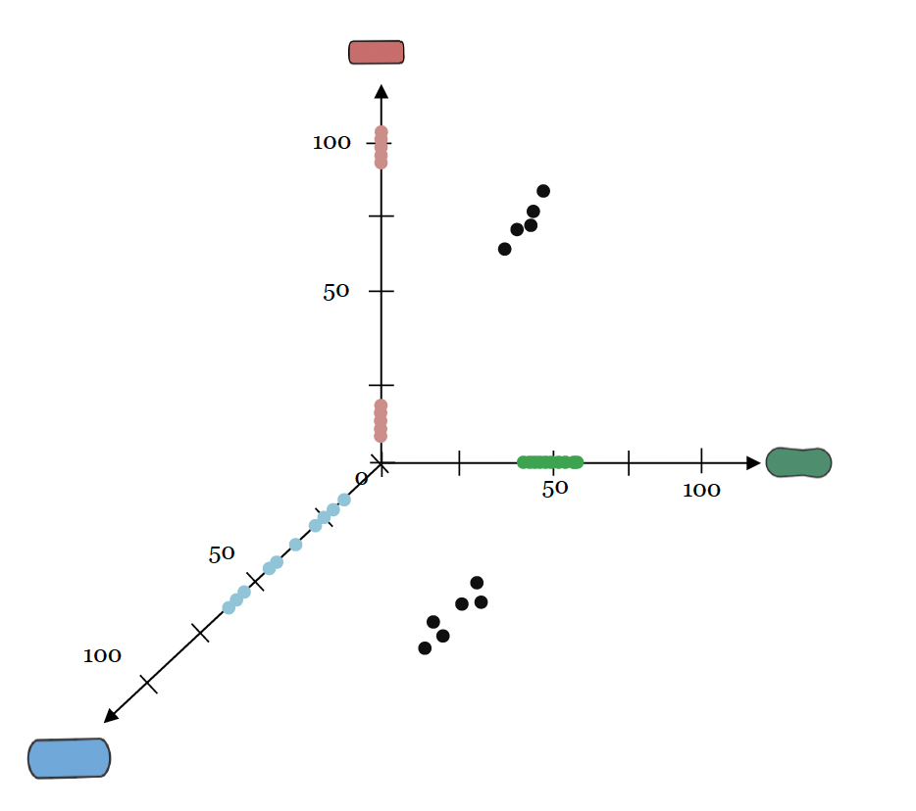
Analyzing the data
Ordination plots
3-dimensions

Slide 34
Analyzing the data
Ordination plots
Principal component analysis: linear ordination technique based on Euclidean distance between samples
Does not handle well datasets with null values (double-zero problem)
Principal coordinate analysis: non-linear ordination technique based on any distance between samples
Non-Metric Multi-Dimensional Scaling: ordination technique based on the ranks of the dissimilarity values between samples (iterative process), using non-metric distances (Bray-Curtis)
Each component returns a score for each sample
The components are ordered according to the percentage of the total variance that they explain
 | Taxon 1 | Taxon 2 … | Taxon C
Sample 1 | 150 | 3540 | 0
Sample 2 | 5200 | 0 | 540
Sample N | 320 | 2009 | 1300
 | PC1 | PC2
Sample 1
Sample 2
Sample N

Slide 35
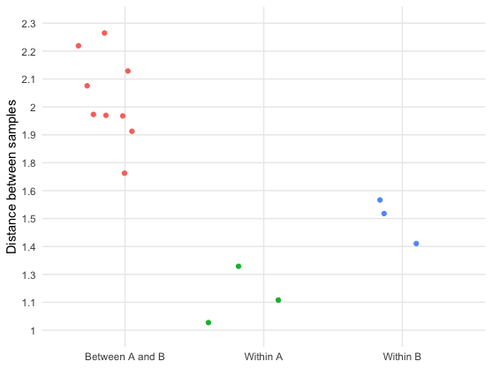
Analyzing the data
Ordination plots
Ordination plots can be used as an explanatory tool
However, consider not (only) doing ordination plots
Difficult to interpret
Often over-interpreted
Depends on the number of samples in the analysis and balance between groups
Other way to visualize the data?
 | A1 | A2 | A3 | B1 | B2 | B3
A1 | 0
A2 | 1 | 0
A3 | 1.1 | 1.3 | 0
B1 | 2.2 | 2.0 | 1.9 | 0
B2 | 2.0 | 1.8 | 2.0 | 1.4 | 0
B3 | 2.3 | 2.1 | 2.1 | 1.5 | 1.6 | 0

Slide 36
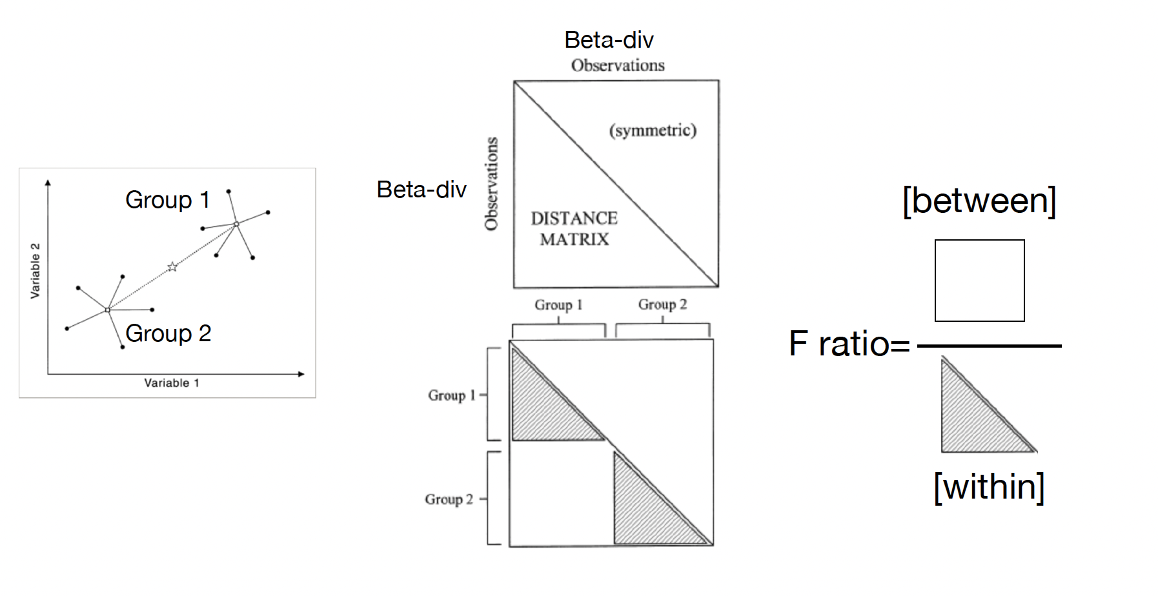
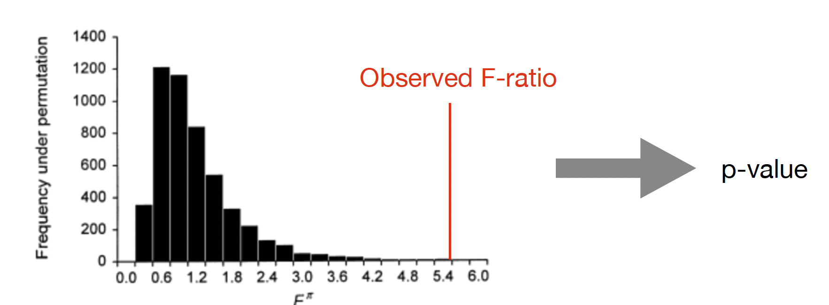
Analyzing the data
Test of 𝛃-diversity
The PERMANOVA test

Slide 37
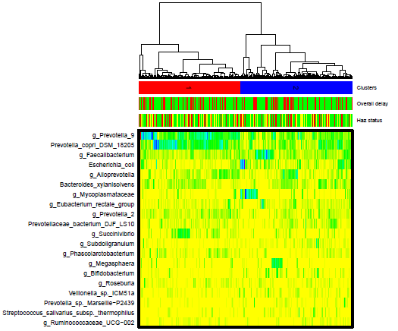
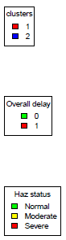
Analyzing the data
Clustering/Classification
Based on between-sample distances, then aggregates samples from smallest to largest distance
How to determine the optimal number of k clusters?
The Calinski-harabasz index, aka variance ratio criterion, is the ratio of the between-groups variance and the within-groups variance

Slide 38
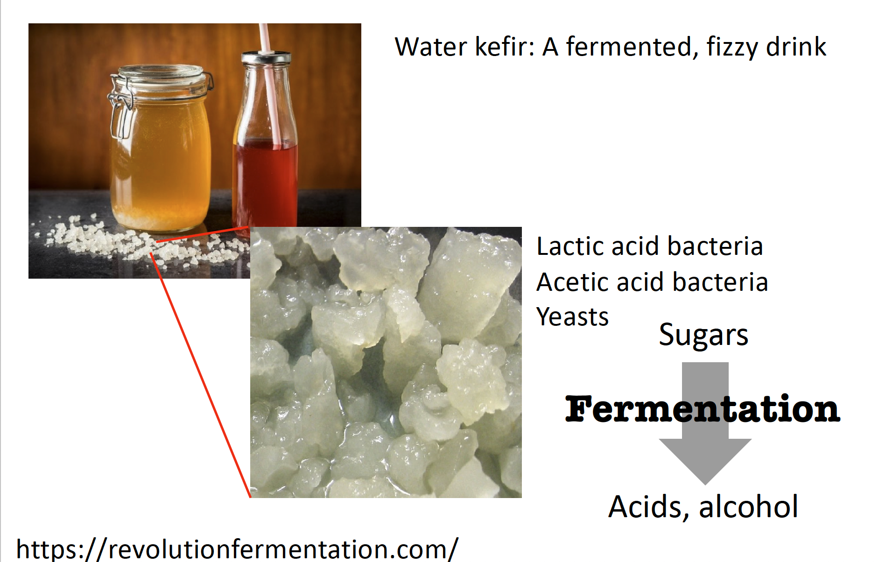
Our topic: water kefir microbiota

Slide 39
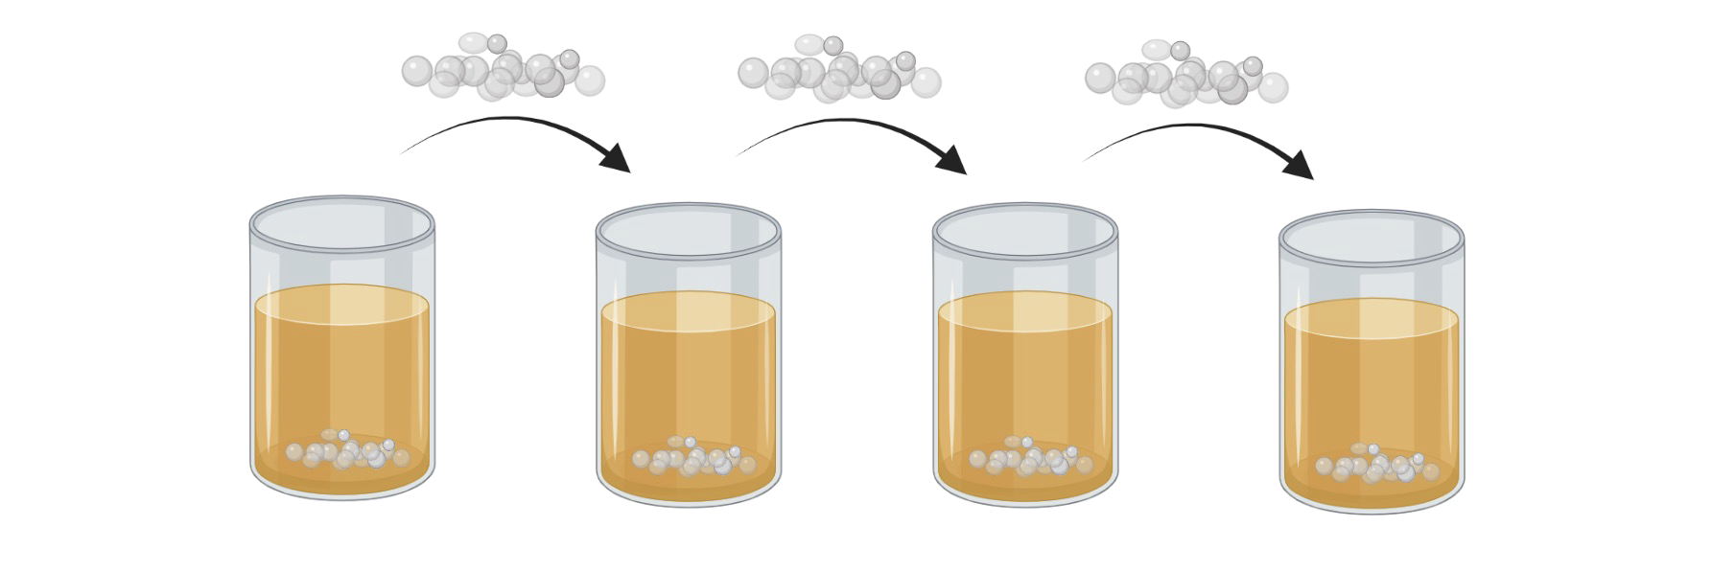
Our topic: water kefir microbiota
Starter culture-based fermentation
Starter cultures of fermented foods are serial passaged

Slide 40
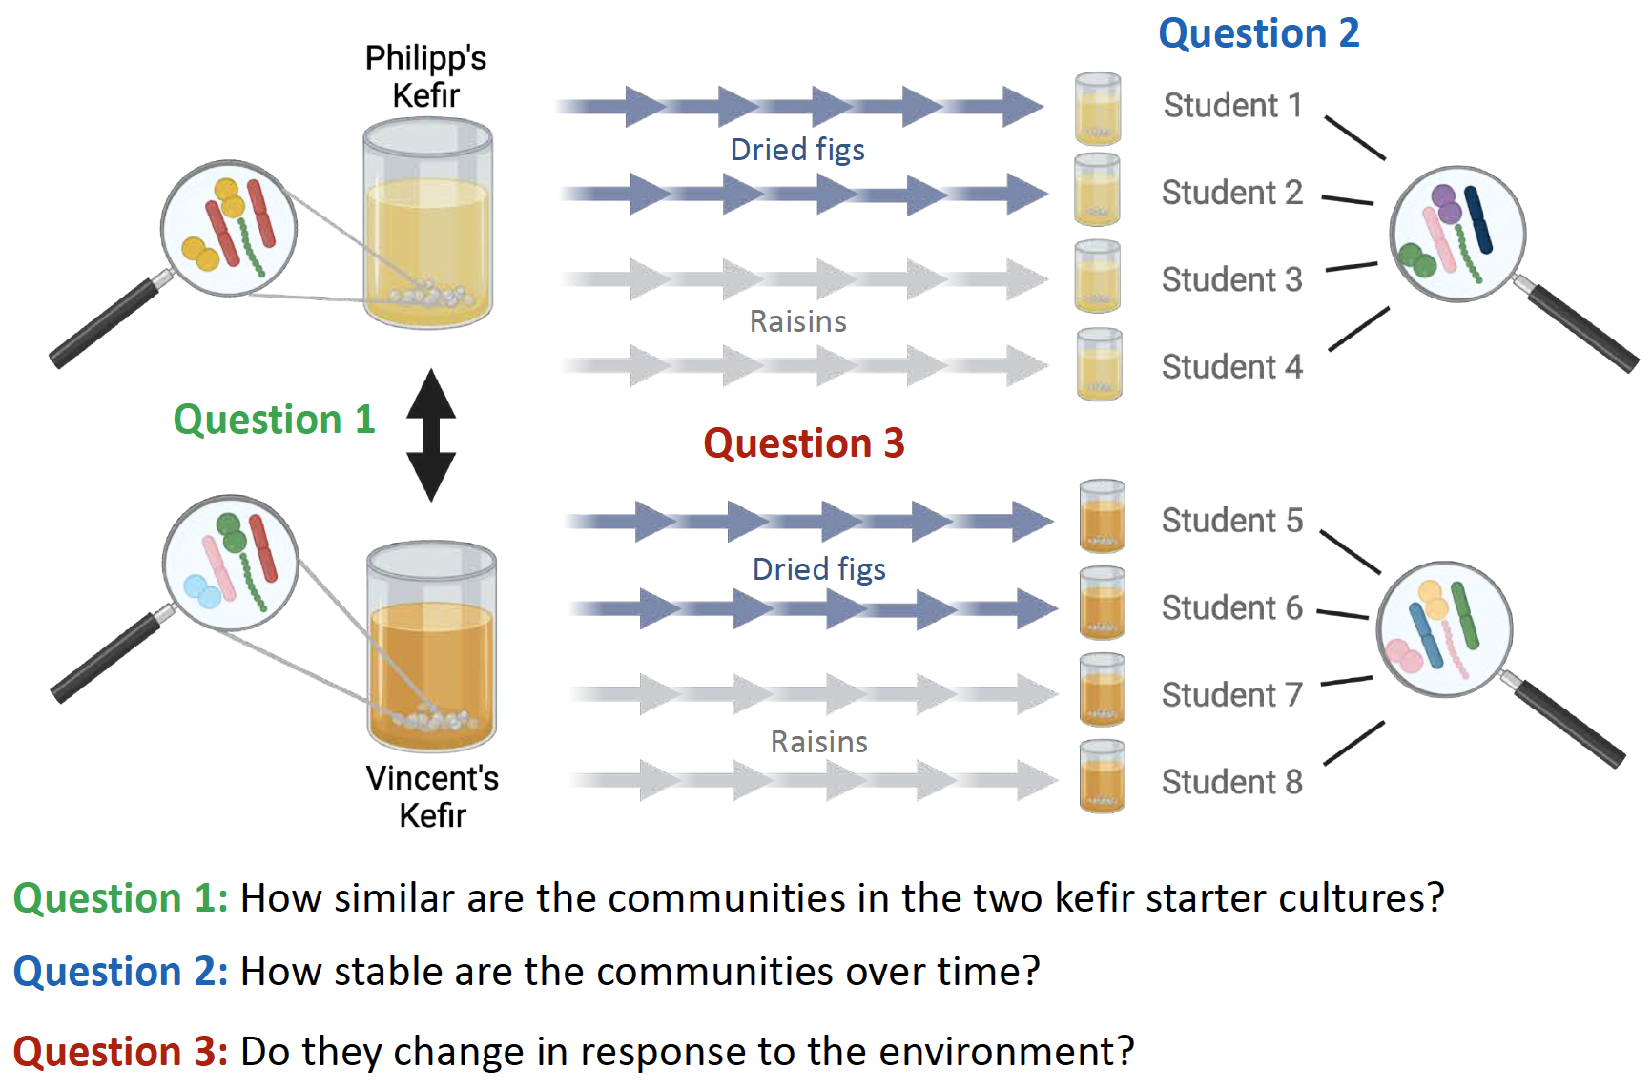
Our topic: water kefir microbiota
Vladimir’s Kefir

Slide 41
Our topic: water kefir microbiota
Question 1: How similar are the communities in the two kefir starter cultures?
Question 2: How stable are the communities over time?
Question 3: Do they change in response to the environment?
Use the metadata table
Q1: inoculum= philipp / vincent
Q2: time = START / END
Q3: subset time = END, fruit = figs / raisins

Slide 42



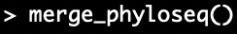
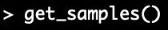

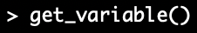


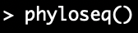
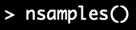

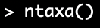



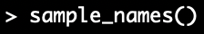
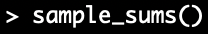




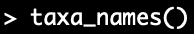






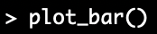

Diversity analyses in R
Accesors
Processors
Count table
Taxonomy table
Phyloseq object
Metadata table
Phylogenetic tree
The Phyloseq package structure

Slide 43
Limits of 16S data analysis
Absolute vs relative abundance
Difficult to input equimolar concentrations
Output read number limited by the instrument
Read count cannot be related to the total molescules in the sample
Final read counts contain only information about ratios (proportions)
Always keep a reference measure of the total cell/DNA/amplicons density in your sample
Notes:
Relative abundance of all taxa change when only one relative abundance changes. Not spurious but misleading

Slide 44
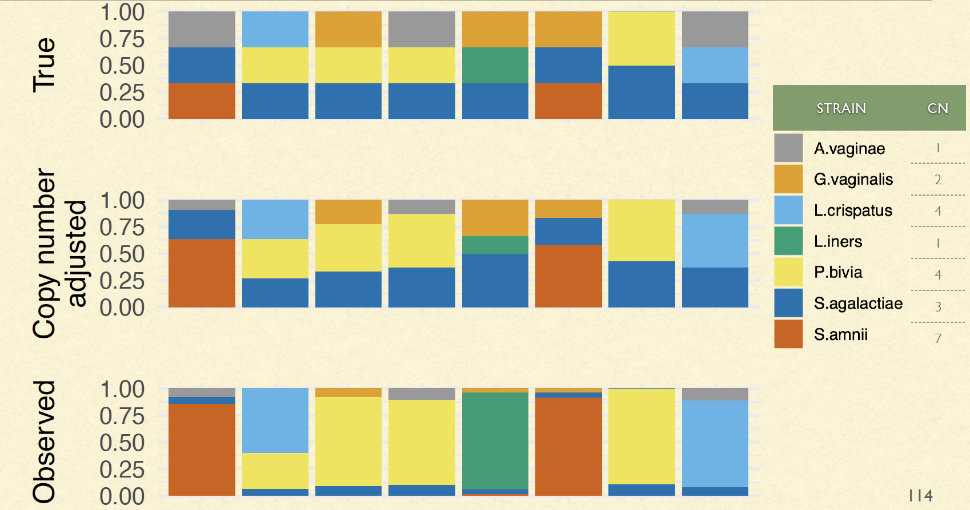
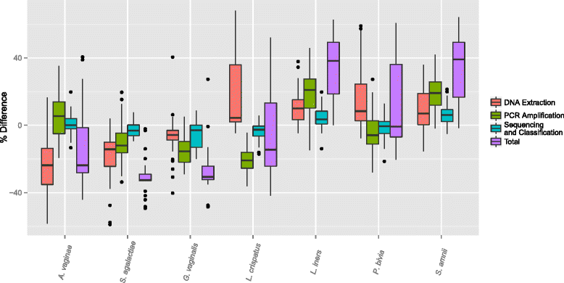
Limits of 16S data analysis
DNA extraction efficacy
Biased amplification due to chosen primers
Different extraction efficiencies for different taxa
16S copy number
Data from Brooks et al. (2015) BMC Microbiology
Notes:
Relative abundance of all taxa change when only one relative abundance changes. Not spurious but misleading
Biased amplification: The choice of primers used for amplification can affect the representation of different microbial taxa, leading to potential biases in the resulting data. For example, some primer sets may amplify certain bacterial phyla more efficiently than others, leading to an over-representation of those taxa in the sequencing results. The expected count is not just the true proportion multiplied by the sampling intensity, but it is also multiplied by a parameter that we could call detection efficiency
Copy number

Slide 45
Limits of 16S data analysis
Limited resolution
Lack of functional information
Notes:
4. Limited resolution: The 16S rRNA gene is not highly variable, and different species may have highly similar sequences. As a result, 16S rRNA gene amplicon sequencing may not be able to distinguish between closely related species or strains. →Inability to capture intra-species variation
5. Lack of functional information: 16S rRNA gene amplicon sequencing provides information about the taxonomic composition of microbial communities but does not provide functional information about the metabolic capabilities of the microorganisms present.

Slide 46
α-diversity
Two approaches
Quick and dirty: calculate indices based on observed counts/proportions
To please statisticians: estimate true population proportions and then calculate indices based on these estimates
The population that you want to study may not be the population that you get to study. Limitations of sampling because of the technology we have access too (ex: sequencing depth)
Sample species richness underestimates total population richness (rarefaction as well)
 | True abundances | Observed abundances
 | 4/15 | 2/5
 | 3/15 | 1/5
 | 4/15 | 1/5
 | 4/15 | 1/5
Notes:
Any function of p1, p2, … pC is a valid alpha diversity parameter

